Slide 1
Data Mining: Exploring Data Dr. Lov Kumar Assistant Professor, BITS Pilani, Hyderabad Campus

Slide 2
What is data exploration?
A preliminary exploration of the data to better understand its characteristics.
Key motivations of data exploration include
Helping to select the right tool for preprocessing or analysis
Making use of humans’ abilities to recognize patterns
People can recognize patterns not captured by data analysis tools

Slide 3
Techniques Used In Data Exploration
In Exploratory Data Analysis (EDA), as originally defined by Tukey
The focus was on visualization
Clustering and anomaly detection were viewed as exploratory techniques
In data mining, clustering and anomaly detection are major areas of interest, and not thought of as just exploratory
In our discussion of data exploration, we focus on
Summary statistics
Visualization
Online Analytical Processing (OLAP)

Slide 4
Summary Statistics
Summary statistics are numbers that summarize properties of the data
Summarized properties include frequency, location and spread
Examples: location - mean spread - standard deviation
Most summary statistics can be calculated in a single pass through the data

Slide 5
Frequency and Mode
The frequency of an attribute value is the percentage of time the value occurs in the data set
For example, given the attribute ‘gender’ and a representative population of people, the gender ‘female’ occurs about 50% of the time.
The mode of a an attribute is the most frequent attribute value
The notions of frequency and mode are typically used with categorical data

Slide 6
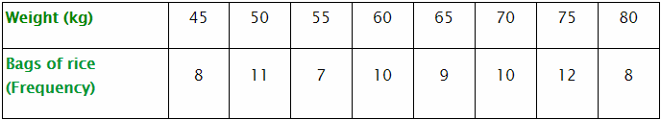
Find the mode of the following set of scores.
14 11 15 9 11 15 11 7 13 12

Slide 7
Percentiles
For continuous data, the notion of a percentile is more useful.
Given an continuous attribute x and a number p between 0 and 100, the pth percentile is a value of x such that p% of the observed values of x are less than
For instance, the 50th percentile is the value such that 50% of all values of x are less than

Slide 8
Order all the values in the data set from smallest to largest.
Multiply k percent by the total number of values, n. This number is called the index.
If the index obtained in Step 2 is not a whole number, round it up to the nearest whole number and go to Step 4a. If the index obtained in Step 2 is a whole number, go to Step 4b.
Step 4a.Count the values in your data set from left to right until you reach the number indicated by Step 3. The corresponding value in your data set is the k^{th} percentile.
Step 4b. Count the values in your data set from left to right until you reach the number indicated by Step 2.
The k^{th} percentile is the average of that corresponding value in your data set and the value that directly follows it.

Slide 9
43, 54, 56, 61, 62, 66, 68, 69, 69, 70, 71, 72, 77, 78, 79, 85, 87, 88, 89, 93, 95, 96, 98, 99, 99
Find the 90th percentile.
Find the 60th percentile.

Slide 10
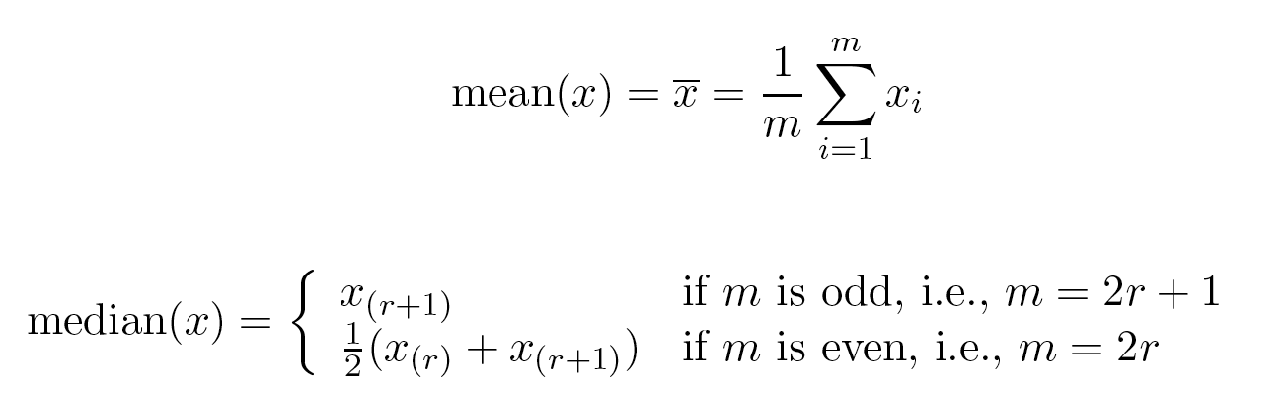
Measures of Location: Mean and Median
The mean is the most common measure of the location of a set of points.
However, the mean is very sensitive to outliers.
Thus, the median or a trimmed mean is also commonly used.

Slide 11
Find the mean, median, and range for the following list of values:
13, 18, 13, 14, 13, 16, 14, 21, 13
The "range" of a list a numbers is just the difference between the largest and smallest values.

Slide 12
Measures of Spread: Range and Variance
Range is the difference between the max and min
The variance or standard deviation is the most common measure of the spread of a set of points.
Variance : The average of the squared differences from the Mean.

Slide 13
Standard deviation
Step 1: Find the mean.
Step 2: For each data point, find the square of its distance to the mean.
Step 3: Sum the values from Step 2.
Step 4: Divide by the number of data points.
Step 5: Take the square root.
Note: If you're dealing with a sample,
Step 4: Divide by the (number of data points-1).
Note: If you're dealing with a population,
Step 4: Divide by the (number of data points).

Slide 14
example for calculating standard deviation
6,2,3,1

Slide 15
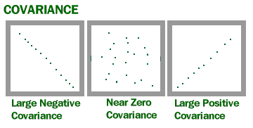

Covariance
Covariance is a measure of how much two random variables vary together. It’s similar to variance, but where variance tells you how a single variable varies, co variance tells you how two variables vary together.

Slide 16
Calculate covariance for the following data set: x: 2.1, 2.5, 3.6, 4.0
y: 8, 10, 12, 14

Slide 17
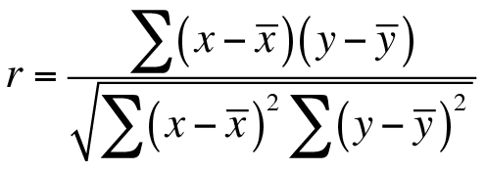
Correlation Coefficient
Correlation coefficient formulas are used to find how strong a relationship is between data. The formulas return a value between -1 and 1, where:
1 indicates a strong positive relationship.
-1 indicates a strong negative relationship.
A result of zero indicates no relationship at all.

Slide 18
SUBJECT | AGE X | GLUCOSE LEVEL Y
1 | 43 | 99
2 | 21 | 65
3 | 25 | 79
4 | 42 | 75
5 | 57 | 87
6 | 59 | 81

Slide 19
Visualization
Visualization is the conversion of data into a visual or tabular format so that the characteristics of the data and the relationships among data items or attributes can be analyzed or reported.
Visualization of data is one of the most powerful and appealing techniques for data exploration.
Humans have a well developed ability to analyze large amounts of information that is presented visually
Can detect general patterns and trends
Can detect outliers and unusual patterns

Slide 20
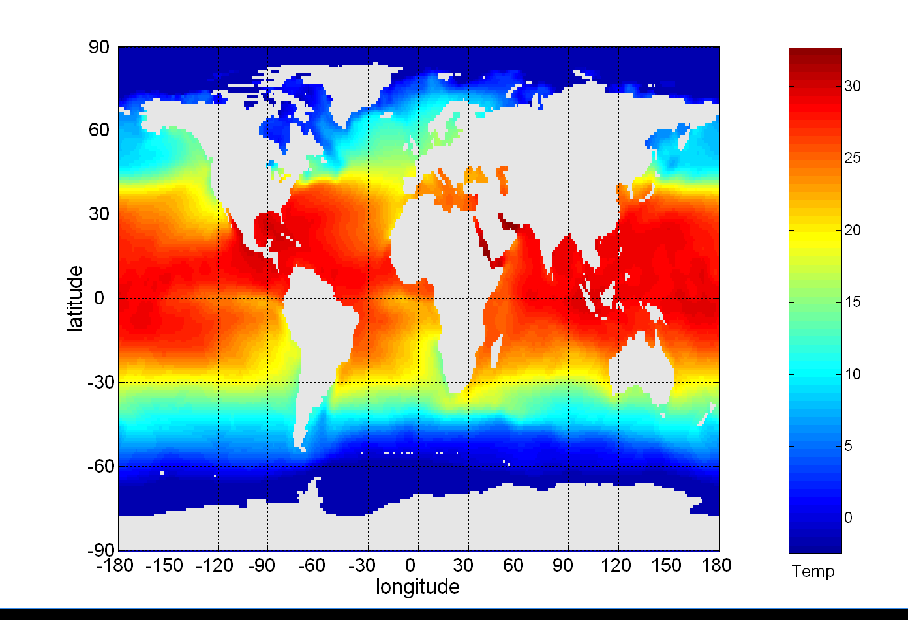
Sea Surface Temperature
The following shows the Sea Surface Temperature (SST) for July 1982
Tens of thousands of data points are summarized in a single figure

Slide 21
Representation
In the mapping of information to a visual format
Data objects, their attributes, and the relationships among data objects are translated into graphical elements such as points, lines, shapes, and colors.
Objects are often represented as points
Their attribute values can be represented as the position of the points or the characteristics of the points, e.g., color, size, and shape
If position is used, then the relationships of points, i.e., whether they form groups or a point is an outlier, is easily perceived.

Slide 22
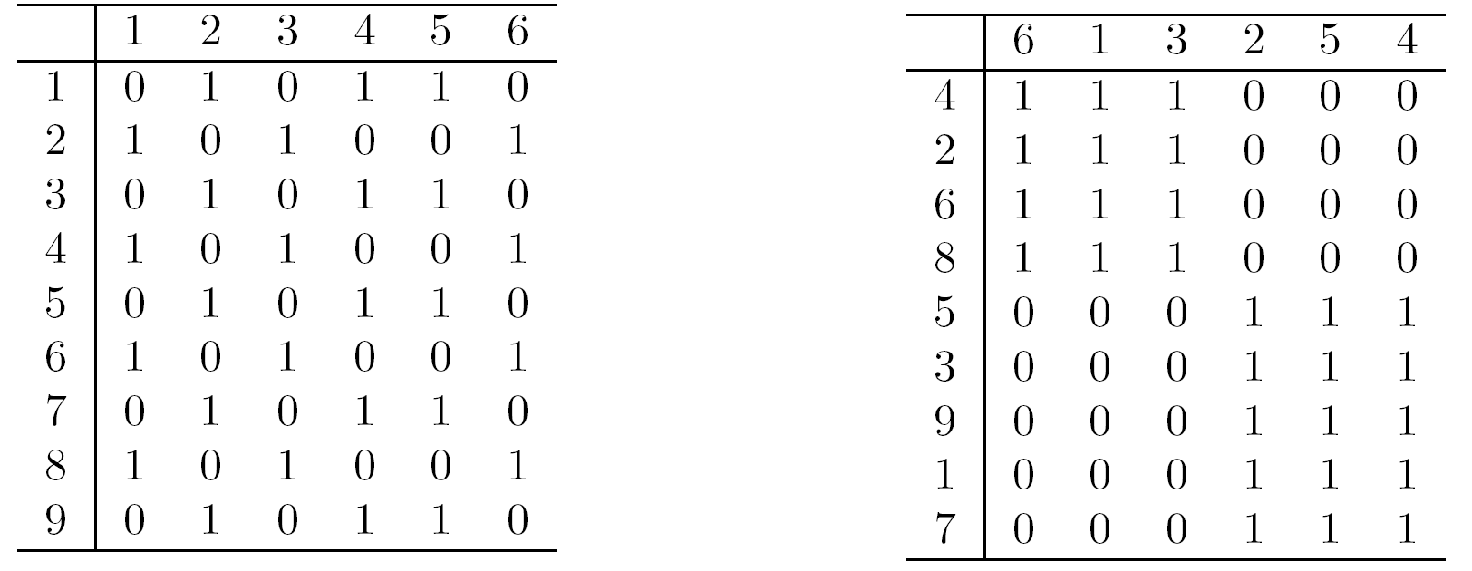
Arrangement
Arrangement Is the placement of visual elements within a display
Can make a large difference in how easy it is to understand the data

Slide 23
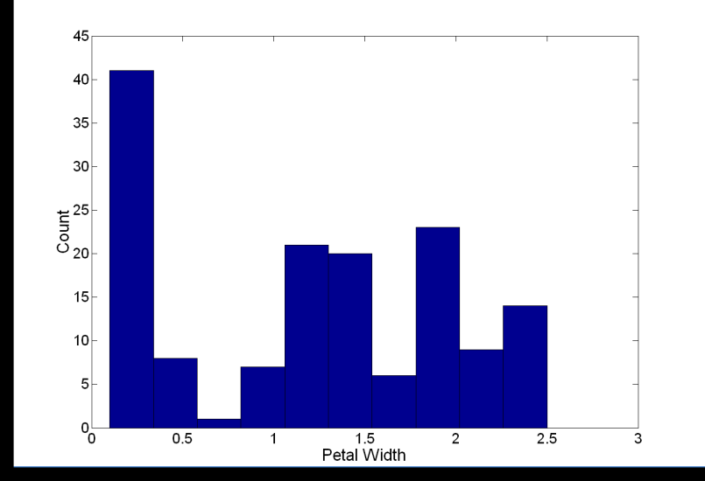
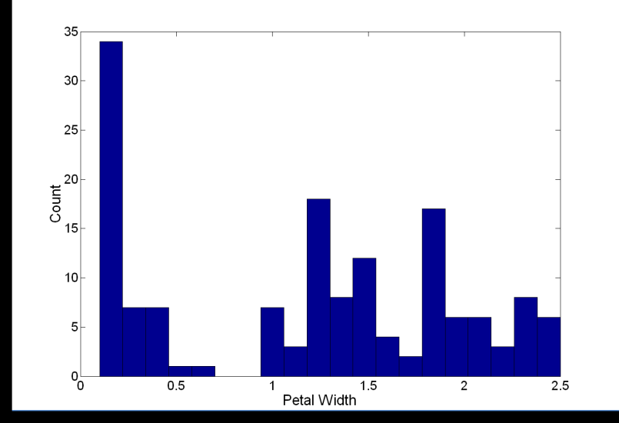
Visualization Techniques: Histograms
Histogram
Usually shows the distribution of values of a single variable
Divide the values into bins and show a bar plot of the number of objects in each bin.
The height of each bar indicates the number of objects
Shape of histogram depends on the number of bins

Slide 24
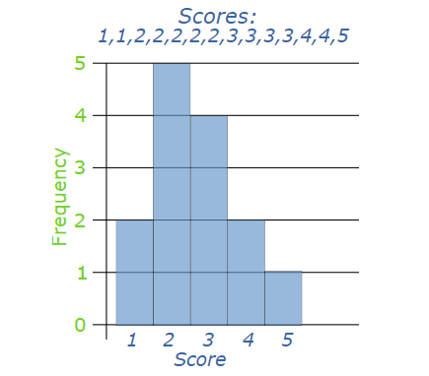

Slide 25
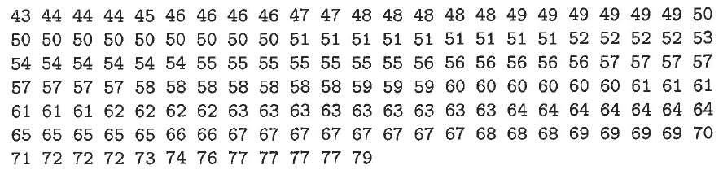
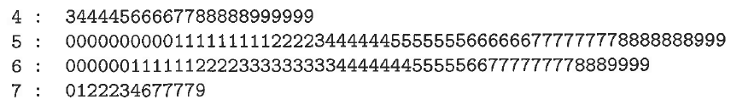

Slide 26
Visualization Techniques: Box Plots
Box Plots
Invented by J. Tukey
Another way of displaying the distribution of data
Following figure shows the basic part of a box plot

Slide 27


Slide 28
Finding the Median of Odd Numbered Data Sets
Once the pieces of data (numbers) are arranged in order from least to greatest, then the middle number of the set is the median
[3, 4, 4, 5, 8, 8, 9, 10,11]
The median for this set of data = 8
The median splits the data set in half.
[3, 4, 4, 5,] 8, [8, 9, 10,11]
Find the upper and lower quartiles as well as the upper and lower extremes.

Slide 29
Lower Quartile
The lower quartile is the median of the bottom half of the data (to the left of the median).
[3, 4, 4, 5,] 8, [8, 9, 10,11]
4 + 4 = 8 8 divided by 2 = 4
The lower quartile for this set of data = 4

Slide 30
Upper Quartile
The upper quartile is the median of the top half of the data (to the right of the median).
[3, 4, 4, 5,] 8, [8, 9, 10,11]
9 + 10 = 19; 19 divided by 2 = 9.5
The upper quartile for this data set = 9.5

Slide 31
Interquartile Range
To find the interquartile range, subtract the lower quartile from the upper quartile.
[3, 4,] 4 [4, 5,] 8, [8, 9] 9.5 [10,11]
Upper Quartile – Lower Quartile = _____
9.5 – 4 = 5.5
The interquartile range for this data = 5.5

Slide 32
Lower Extreme and Upper Extreme
The lower extreme is the lowest number in the data set.
[3, 4,] 4 [4, 5,] 8, [8, 9] 9.5 [10,11]
The lower extreme for this data set = 3
The upper extreme is the highest number in the data set.
[3, 4,] 4 [4, 5,] 8, [8, 9] 9.5 [10,11]
The upper extreme for this data set = 11

Slide 33
5 Number Summary
[3, 4, 4, 5, 8, 8, 9, 10,11]
Median = 8
Lower Quartile = 4
Upper Quartile = 9.5
Lower Extreme = 3
Upper Extreme = 11

Slide 34
Criteria for Outliers
The following is criteria to identify outliers in a data set.
The inter-quartile range (IQR) is the value of Q3 – Q1
x is an outlier if of one the following inequalities is true:
x > Q₃ + 1.5 x IQR
x < Q₁ - 1.5 x IQR
Does our data have any outliers?

Slide 35
Visualization Techniques: Scatter Plots
Scatter plots
Attributes values determine the position
Two-dimensional scatter plots most common, but can have three-dimensional scatter plots
Often additional attributes can be displayed by using the size, shape, and color of the markers that represent the objects
It is useful to have arrays of scatter plots can compactly summarize the relationships of several pairs of attributes

Slide 36
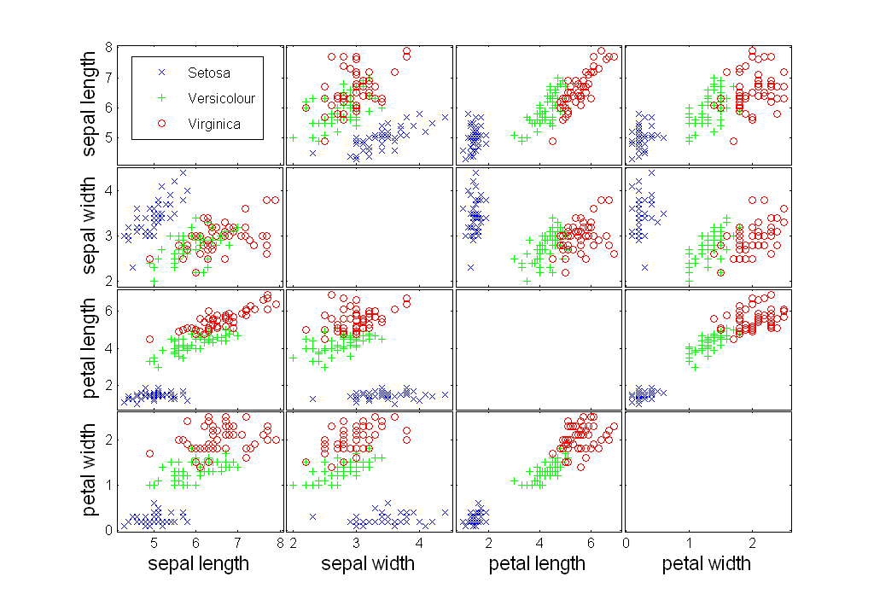

Slide 37
Visualization Techniques: Contour Plots
Contour plots
Useful when a continuous attribute is measured on a spatial grid
They partition the plane into regions of similar values
The contour lines that form the boundaries of these regions connect points with equal values
The most common example is contour maps of elevation
Can also display temperature, rainfall, air pressure, etc.
An example for Sea Surface Temperature (SST) is provided on the next slide

Slide 38
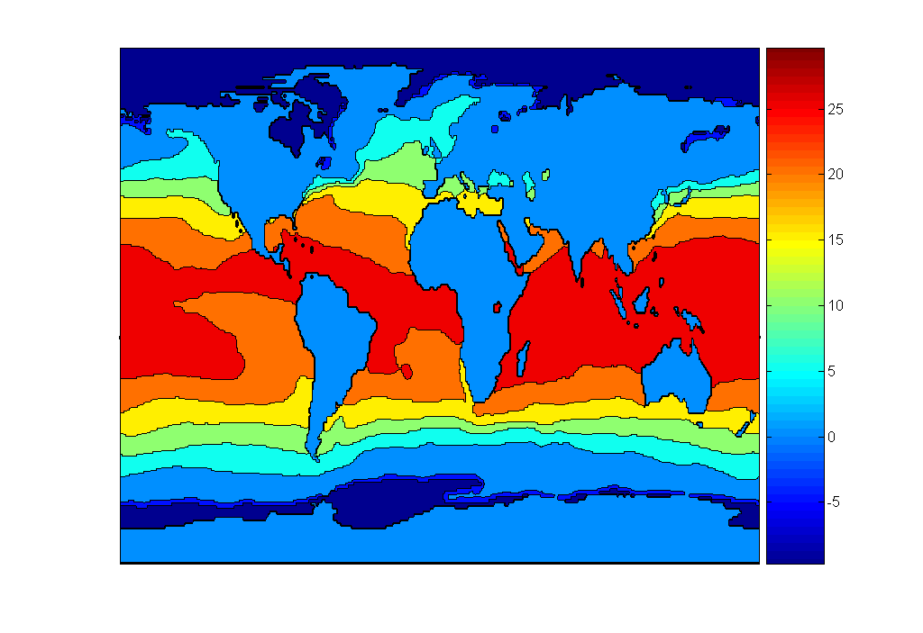
Celsius

Slide 39
Visualization Techniques: Matrix Plots
Matrix plots
Can plot the data matrix
This can be useful when objects are sorted according to class
Typically, the attributes are normalized to prevent one attribute from dominating the plot
Plots of similarity or distance matrices can also be useful for visualizing the relationships between objects

Slide 40
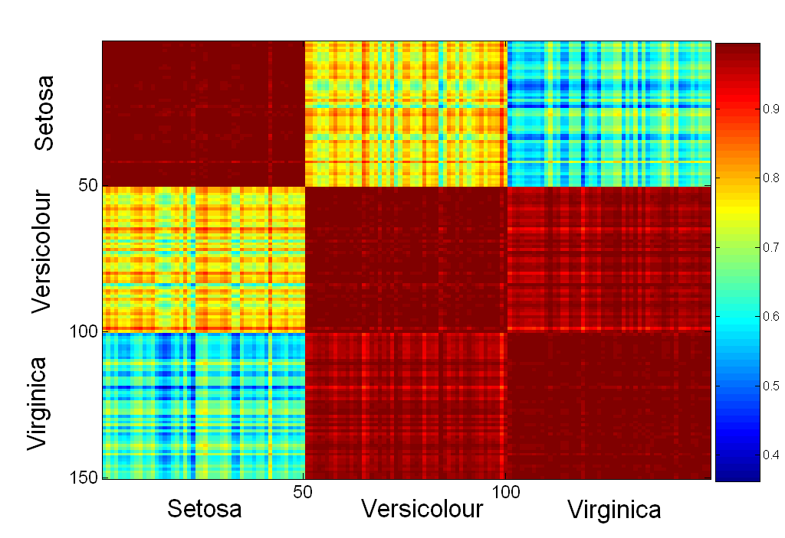

Slide 41
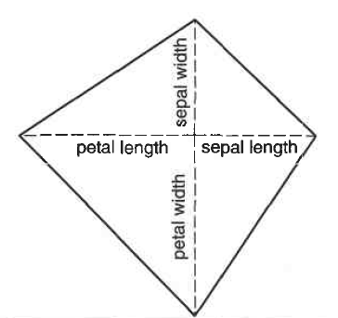
Other Visualization Techniques
Star Plots
Similar approach to parallel coordinates, but axes radiate from a central point
The line connecting the values of an object is a polygon

Slide 42
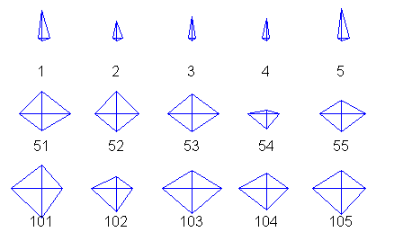
Setosa
Versicolour
Virginica

Slide 43
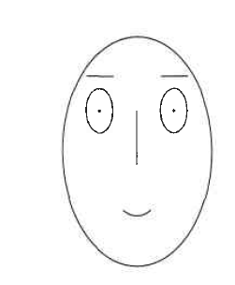
Chernoff Faces
Approach created by Herman Chernoff.
This approach associates each attribute with a characteristic of a face.
The values of each attribute determine the appearance of the corresponding facial characteristic.
Each object becomes a separate face.
Relies on human’s ability to distinguish faces.

Slide 44
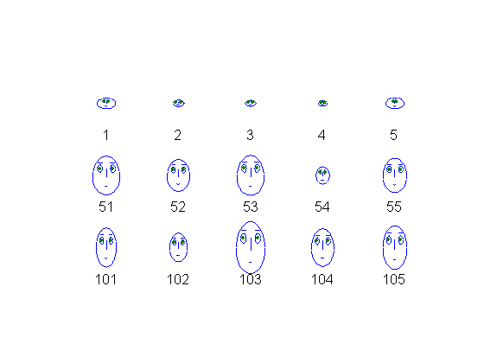
Setosa
Versicolour
Virginica

Slide 45
OLAP
On-Line Analytical Processing (OLAP) was proposed by E. F. Codd, the father of the relational database.
Relational databases put data into tables, while OLAP uses a multidimensional array representation.
There are a number of data analysis and data exploration operations that are easier with such a data representation.

